Slide 1
A’ class
Parts of the face

Slide 2
What’s missing?
That’s great! It’s a nose!

Slide 3
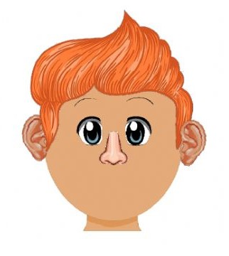
What’s missing?
That’s right! It’s a mouth!

Slide 4
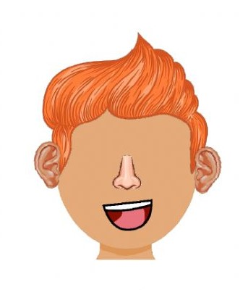
What’s missing?
That’s correct! Eyes are missing!

Slide 5
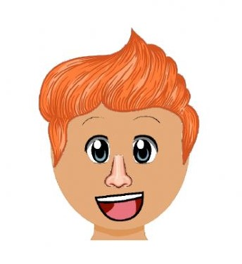
What’s missing?
That’s right! Ears are missing!

Slide 6
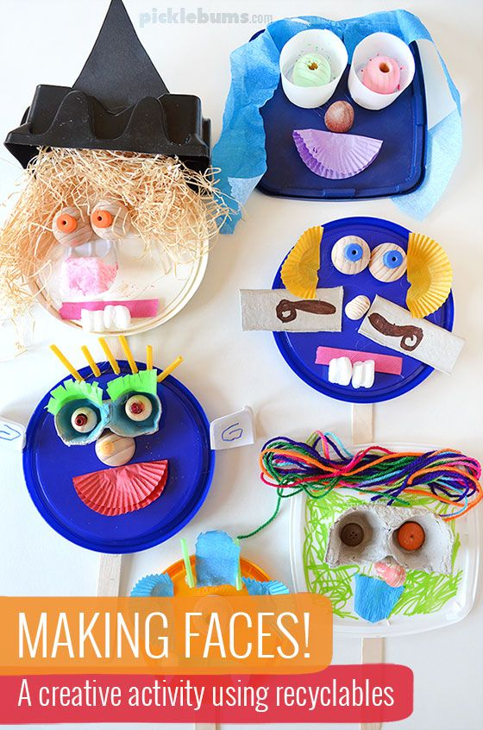
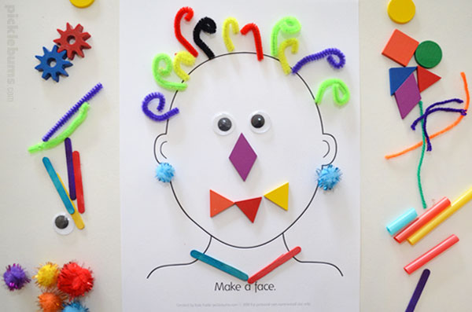
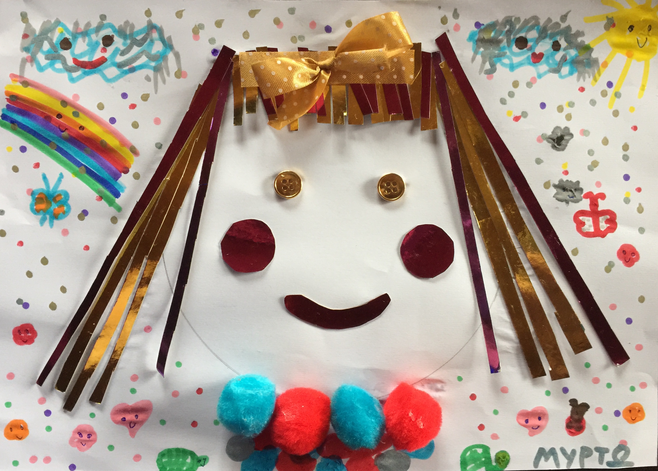
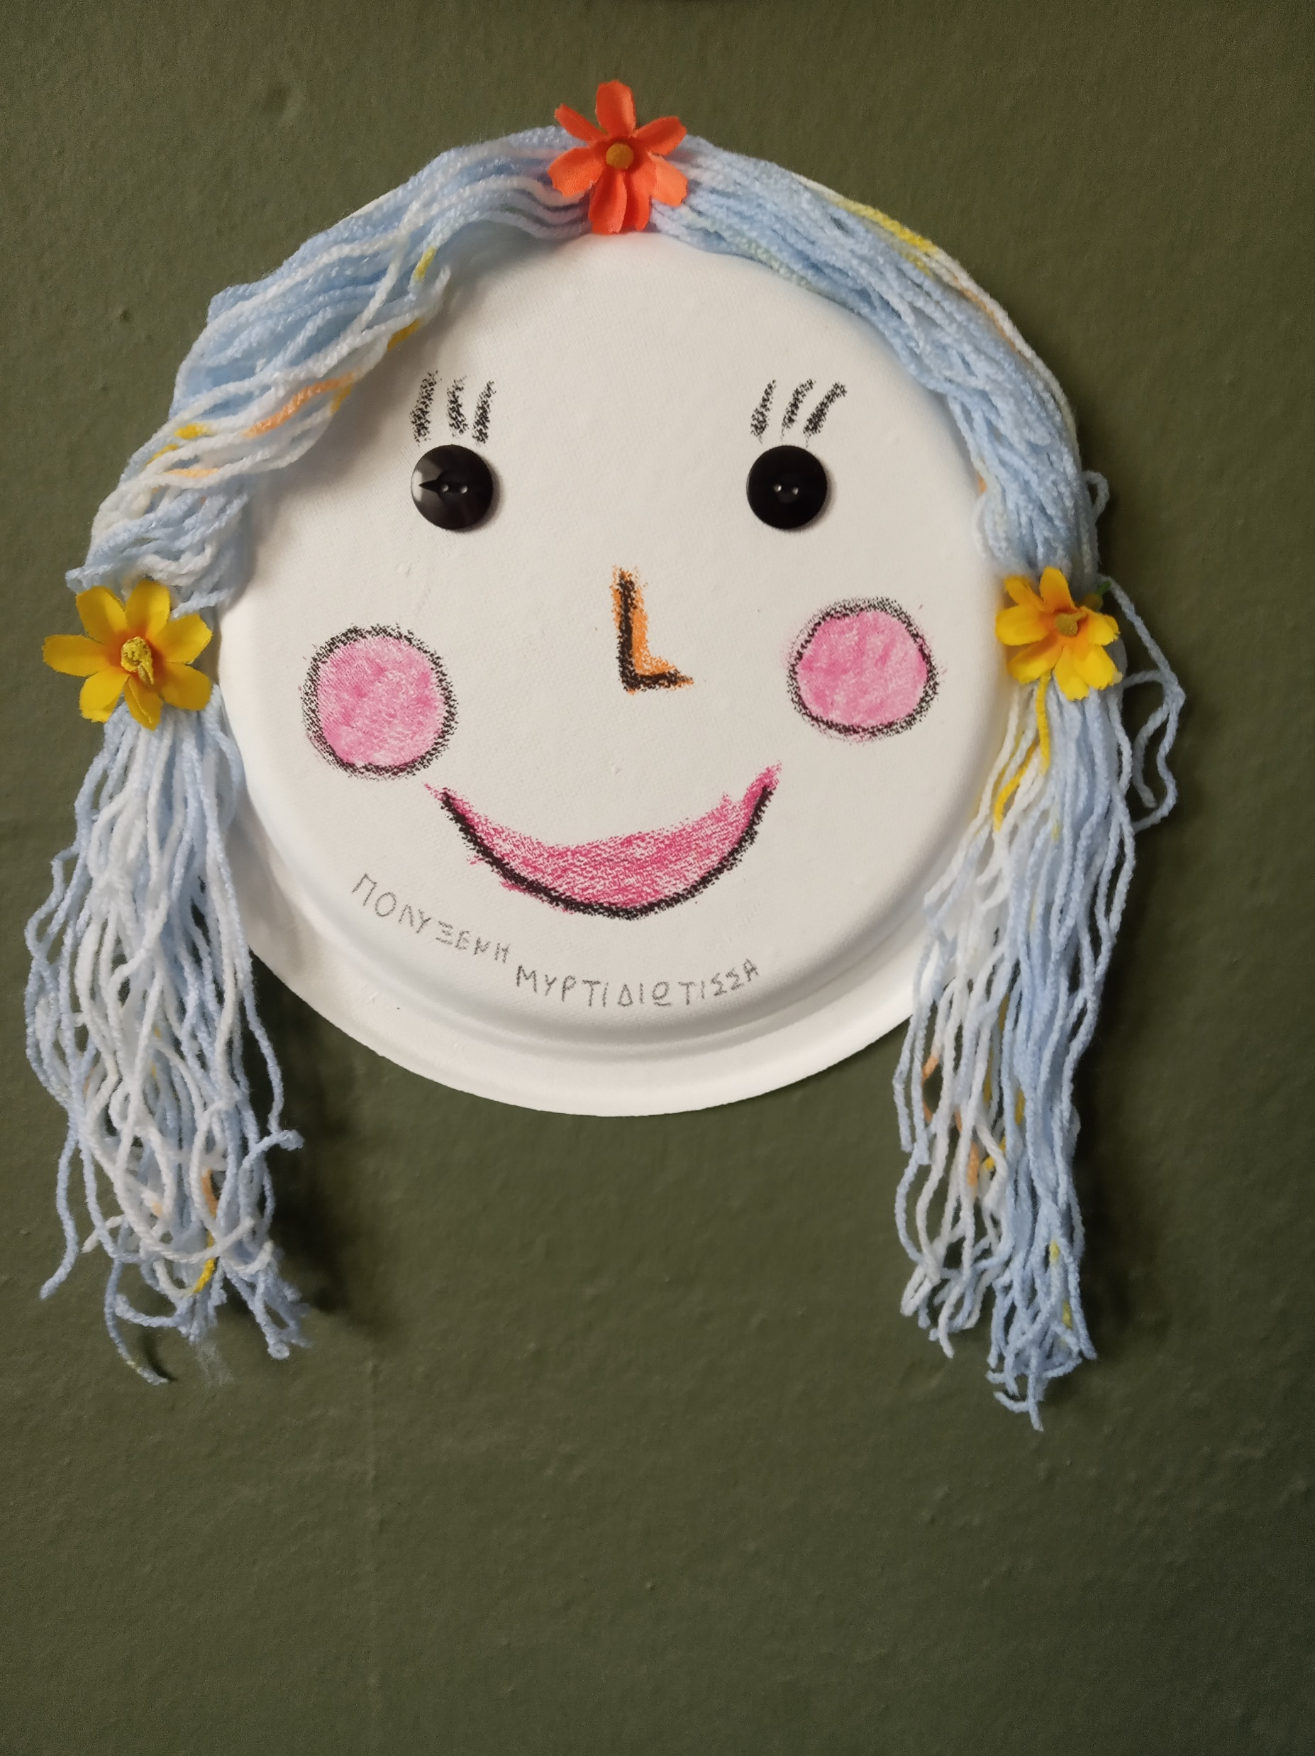
That’s amazing!
You remembered all the parts of the face! Now it’s time to make your own face! Can’t wait to see your creations!

