Slide 1


The Time

Slide 2

In English the minutes come before the hours.
It’s twenty past one.
Key words
● o’clock
ακριβώς
● quarter
τέταρτο
● half
μισή
● past
και
● to
παρά

Slide 3
o’clock
12
11
1
five past
five to
10
2
ten to
ten past
9
3
quarter past
quarter to
8
4
twenty to
twenty past
7
5
6
twenty-five to
twenty-five past
half past

Slide 4
Let’s have a look at some examples.
2:00
It’s two o’clock.
8:15
It’s quarter past eight.
10:30
It’s half past ten.
11:20
It’s twenty past eleven.

Slide 5
12:40
It’s twenty to one.
9:45
It’s quarter to ten.
14:55
It’s five to three.

Slide 6


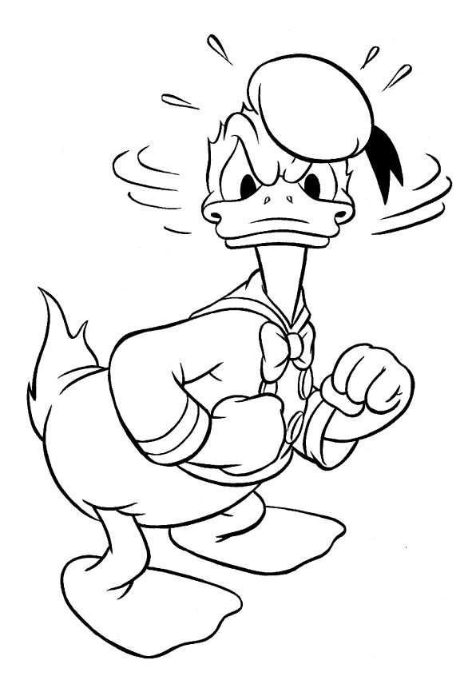
Excuse. me! What is the time, please?
It’s half past seven.
Excuse me! What time is it,please?
Grrr, I’m late again!!!

Slide 7
Before the time we use the preposition at
Note
● School starts at quarter past eight.
● I usually get up at half past seven.

Slide 8
Expressions
with the word time.
εεκφράσεις
1. Time flies.
Ο χρόνος περνάει γρήγορα.
2. Time will tell.
Ο χρόνος θα (το) δείξει.
3. Long time no see.
Χρόνια και ζαμάνια (όταν έχουμε καιρό να δούμε κάποιον).
4. Have a good time .
Περνάω καλά.
5. ...at the same time .
...ταυτόχρονα.
6. ...from time to time .
...από καιρό σε καιρό.
…ακριβώς στην ώρα μου.
7. ...on time .

