Slide 1
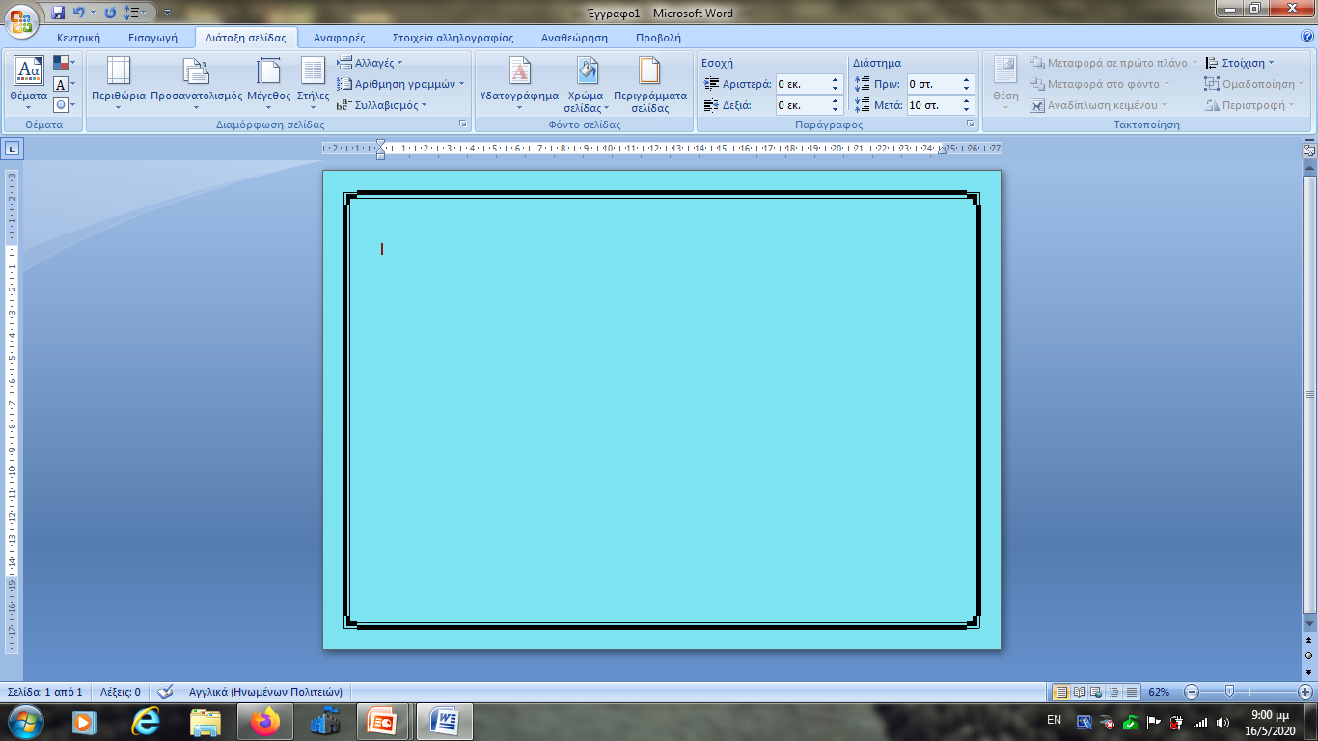
Past Simple

Slide 2
Form: Subject + Verb + -ed
Regular
verbs
I walked
You walked
He walked
She walked
It walked
We walked
You walked
They walked
I did not (didn’t) walk
You did not (didn’t) walk
He did not (didn’t) walk
She did not (didn’t) walk
It did not (didn’t) walk
We did not (didn’t) walk
You did not (didn’t) walk
They did not (didn’t) walk
Did I walk?
Did you walk?
Did he walk?
Did she walk?
Did it walk?
Did we walk?
Did you walk?
Did they walk?
Affirmative
Negative
Interrogative

Slide 3
Spelling rules
1. verbs ending in e
d
dance → danced
2. verbs ending in consonant + y
y ied
hurry → hurried
but
vowel+ y
ed
stay → stayed

Slide 4


3. cvc
double consonant + ed
consonant-vowel-consonant
σύμφωνο-φωνήεν-σύμφωνο
stop → stopped
Except
x, w, y
fix → fixed
travel → travelled
4. consonant + l
travel → traveled

Slide 5
Form: Subject + 2nd column
Irregular
verbs
στήλη
I broke
You broke
He broke
She broke
It broke
We broke
You broke
They broke
I did not (didn’t) break
You did not (didn’t) break
He did not (didn’t) break
She did not (didn’t) break
It did not (didn’t) break
We did not (didn’t) break
You did not (didn’t) break
They did not (didn’t) break
Did I break?
Did you break?
Did he break?
Did she break?
Did it break?
Did we break?
Did you break?
Did they break?
Affirmative
Negative
Interrogative

Slide 6
Irregular
verbs
The verb “to be”
I was
You were
He was
She was
It was
We were
You were
They were
I was not (wasn’t)
You were not (weren’t)
He was not (wasn’t)
She was not (wasn’t)
It was not (wasn’t)
We were not (weren’t)
You were not (weren’t)
They were not (weren’t)
Was I?
Were you?
Was he?
Was she?
Was it?
Were we?
Were you?
Were they?
Affirmative
Negative
Interrogative

Slide 7
use

Slide 8
1. for actions that happened at a specific time which is known or implied

Slide 9

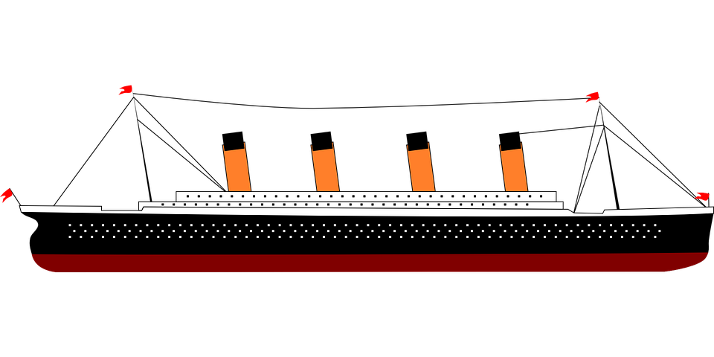

The Titanic sank in 1912.

Slide 10
2. for actions which happened one after the other

Slide 11


She brushed her teeth and went to bed.

Slide 12
3. to talk about past habits or states which have changed
(often with adverbs of frequency)
*we can also use the expression “used to”

Slide 13
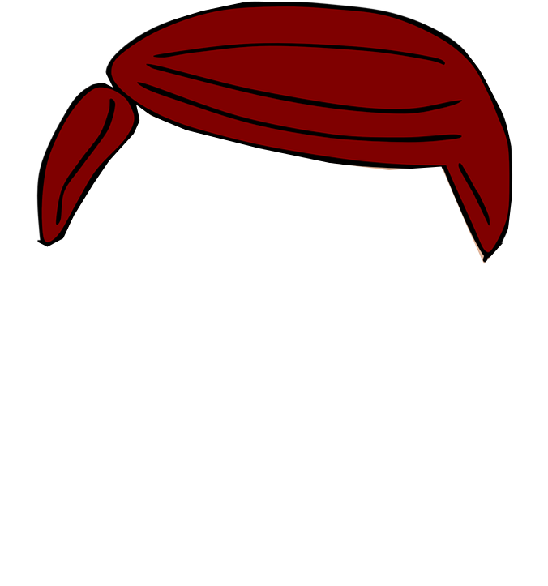
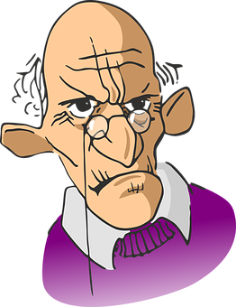
When he was younger he had hair.

Slide 14
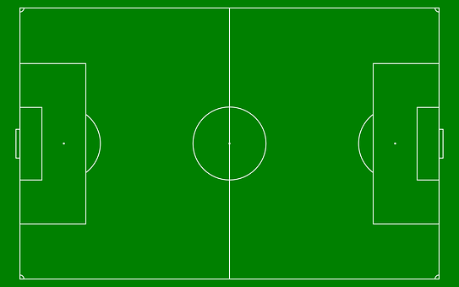

I played football when I was a teenager, but now I prefer tennis.

Slide 15
4. to talk about people that are no longer alive

Slide 16







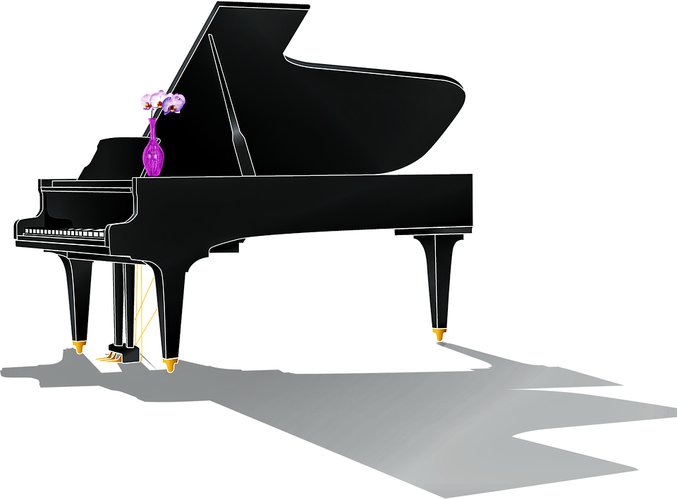
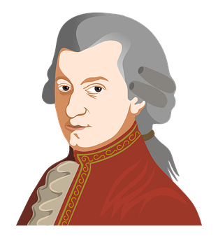

3
4
Mozart composed beautiful music.

Slide 17
Time expressions
yesterday, last week/month/year…, two days ago…, when, then, always, never, sometimes, often, usually, rarely, seldom, how long ago

Slide 18
There is a list of the irregular verbs. Click on your mouse if you want to have a look at it

Slide 19
Irregular Verbs
 | Infinitive | Past | Past Participle | Meaning
1 | be | was/were | been | είμαι
2 | bear | bore | born | γεννώ/ υποφέρω
3 | beat | beat | beaten | νικώ/ χτυπώ
4 | become | became | become | γίνομαι
5 | begin | began | begun | αρχίζω
6 | bend | bent | bent | σκύβω/ λυγίζω
7 | bet | bet | bet | στοιχηματίζω
8 | bite | bit | bitten | δαγκώνω
9 | blow | blew | blown | φυσάω
10 | break | broke | broken | σπάω
11 | bring | brought | brought | φέρνω
12 | build | built | built | κτίζω
13 | burn | burnt/burned | burnt/burned | καίω
14 | burst | burst | burst | εκρήγνυμαι
15 | buy | bought | bought | αγοράζω
16 | can | could | been able to | μπορώ
17 | catch | caught | caught | πιάνω
18 | choose | chose | chosen | διαλέγω

Slide 20
19 | come | came | come | έρχομαι
20 | cost | cost | cost | κοστίζω
21 | cut | cut | cut | κόβω
22 | deal | dealt | dealt | αντιμετωπίζω
23 | dig | dug | dug | σκάβω
24 | do | did | done | κάνω
25 | draw | drew | drawn | ζωγραφίζω
26 | dream | dreamt/dreamed | dreamt/dreamed | ονειρεύομαι
27 | drink | drank | drunk | πίνω
28 | drive | drove | driven | οδηγώ
29 | eat | ate | eaten | τρώω
30 | fall | fell | fallen | πέφτω
31 | feed | fed | fed | ταίζω
32 | feel | felt | felt | αισθάνομαι
33 | fight | fought | fought | πολεμάω/μαλώνω
34 | find | found | found | βρίσκω
35 | fly | flew | flown | πετάω
36 | forbid | forbade | forbidden | απαγορεύω
37 | forget | forgot | forgotten | ξεχνώ
38 | forgive | forgave | forgiven | συγχωρώ
39 | freeze | froze | frozen | παγώνω

Slide 21
40 | get | got | got/gotten | παίρνω
41 | give | gave | given | δίνω
42 | go | went | gone | πηγαίνω
43 | grow | grew | grown | μεγαλώνω/καλλιεργώ
44 | hang | hung | hung | κρεμώ
45 | have | had | had | έχω
46 | hear | heard | heard | ακούω
47 | hide | hid | hidden | κρύβω
48 | hold | held | held | κρατάω
49 | hurt | hurt | hurt | πληγώνω
50 | keep | kept | kept | κρατάω
51 | know | knew | known | ξέρω
52 | lay | laid | laid | τοποθετώ
53 | lead | led | led | οδηγώ/ηγούμαι
54 | learn | learnt/learned | learnt/learned | μαθαίνω
55 | leave | left | left | φεύγω/αφήνω
56 | lend | lent | lent | δανείζω
57 | let | let | let | επιτρέπω
58 | lie | lay | lain | ξαπλώνω
59 | light | lit | lit | ανάβω
60 | lose | lost | lost | χάνω

Slide 22
61 | make | made | made | φτιάχνω
62 | mean | meant | meant | εννοώ/σημαίνω
63 | meet | met | met | συναντώ
64 | pay | paid | paid | πληρώνω
65 | put | put | put | βάζω
66 | read | read | read | διαβάζω
67 | ride | rode | ridden | καβαλάω
68 | ring | rang | rung | κουδουνίζω/χτυπώ
69 | rise | rose | risen | σηκώνομαι/ανεβαίνω
70 | run | ran | run | τρέχω
71 | say | said | said | λέω
72 | see | saw | seen | βλέπω
73 | seek | sought | sought | ψάχνω
74 | sell | sold | sold | πουλάω
75 | send | sent | sent | στέλνω
76 | set | set | set | βάζω/δύω
77 | sew | sewed | sewn | ράβω
78 | shake | shook | shaken | κουνάω
79 | shine | shone | shone | λάμπω
80 | shoot | shot | shot | πυροβολώ

Slide 23
81 | show | showed | shown/showed | δείχνω
82 | shut | shut | shut | κλείνω
83 | sing | sang | sung | τραγουδάω
84 | sink | sank | sunk | βουλιάζω
85 | sit | sat | sat | κάθομαι
86 | sleep | slept | slept | κοιμάμαι
87 | smell | smelt/smelled | smelt/smelled | μυρίζω
88 | speak | spoke | spoken | μιλάω
89 | spell | spelt/spelled | spelt/spelled | συλλαβίζω
90 | spend | spent | spent | ξοδεύω
91 | spill | spilt | spilt | χύνω
92 | split | split | split | χωρίζω
93 | spoil | spoilt/spoiled | spoilt/spoiled | χαλάω
94 | spread | spread | spread | (εξ)απλώνω
95 | spring | sprang | sprung | ανθίζω

Slide 24
96 | stand | stood | stood | στέκομαι
97 | steal | stole | stolen | κλέβω
98 | stick | stuck | stuck | κολλάω
99 | sting | stung | stung | τσιμπάω/κεντρίζω
100 | strike | struck | struck | χτυπάω
101 | swear | swore | sworn | ορκίζομαι
102 | sweep | swept | swept | σκουπίζω
103 | swim | swam | swum | κολυμπάω
104 | take | took | taken | παίρνω
105 | teach | taught | taught | διδάσκω
106 | tear | tore | torn | σκίζω
107 | tell | told | told | λέω
108 | think | thought | thought | σκέπτομαι
109 | throw | threw | thrown | πετάω κάτι
110 | understand | understood | understood | καταλαβαίνω
111 | upset | upset | upset | αναστατώνω
112 | wake | woke | woken | ξυπνάω
113 | wear | wore | worn | φοράω
114 | win | won | won | κερδίζω
115 | write | wrote | written | γράφω

