Slide 1
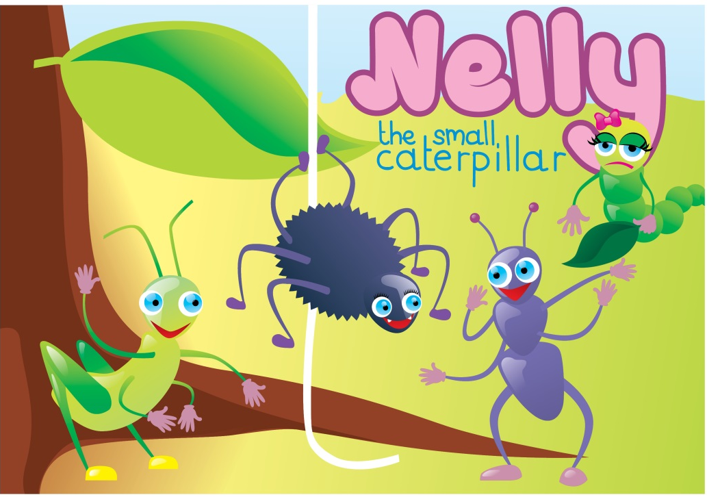
Nelly the small caterpillar

Slide 3
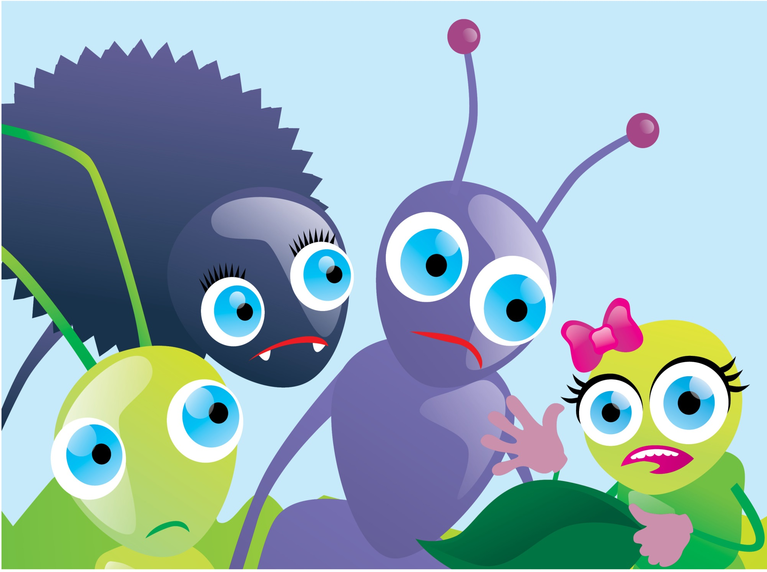

Slide 4
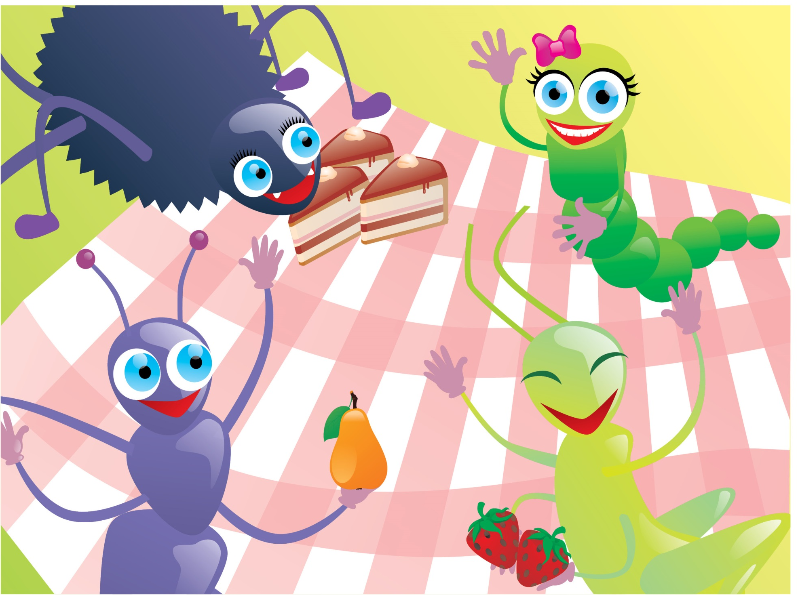

Slide 5
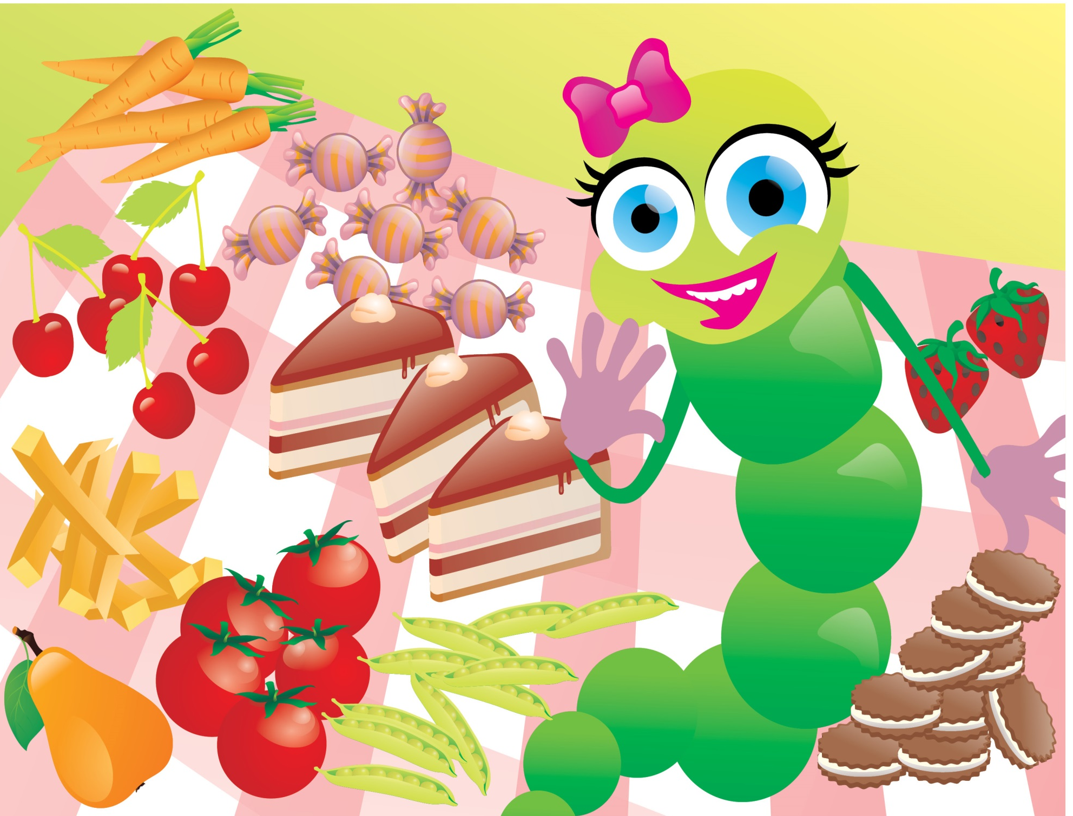

Slide 6
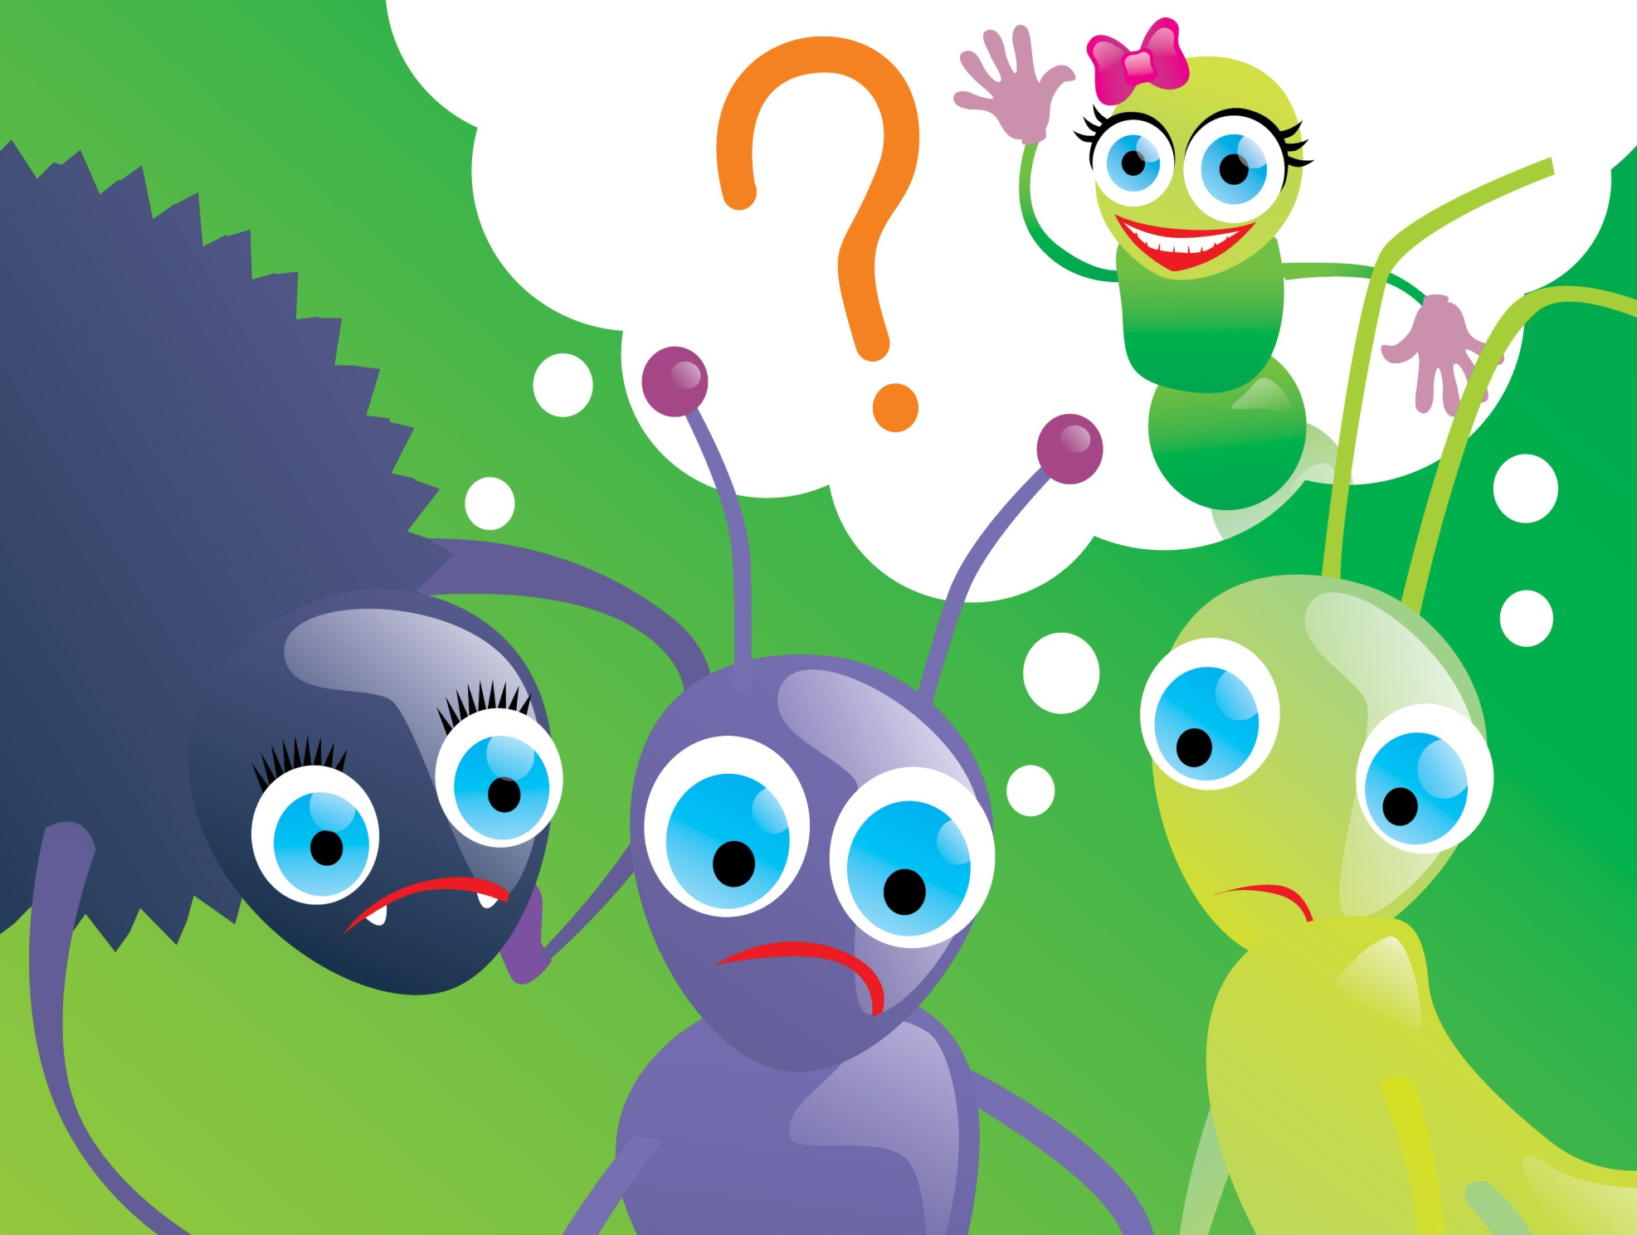

Slide 7
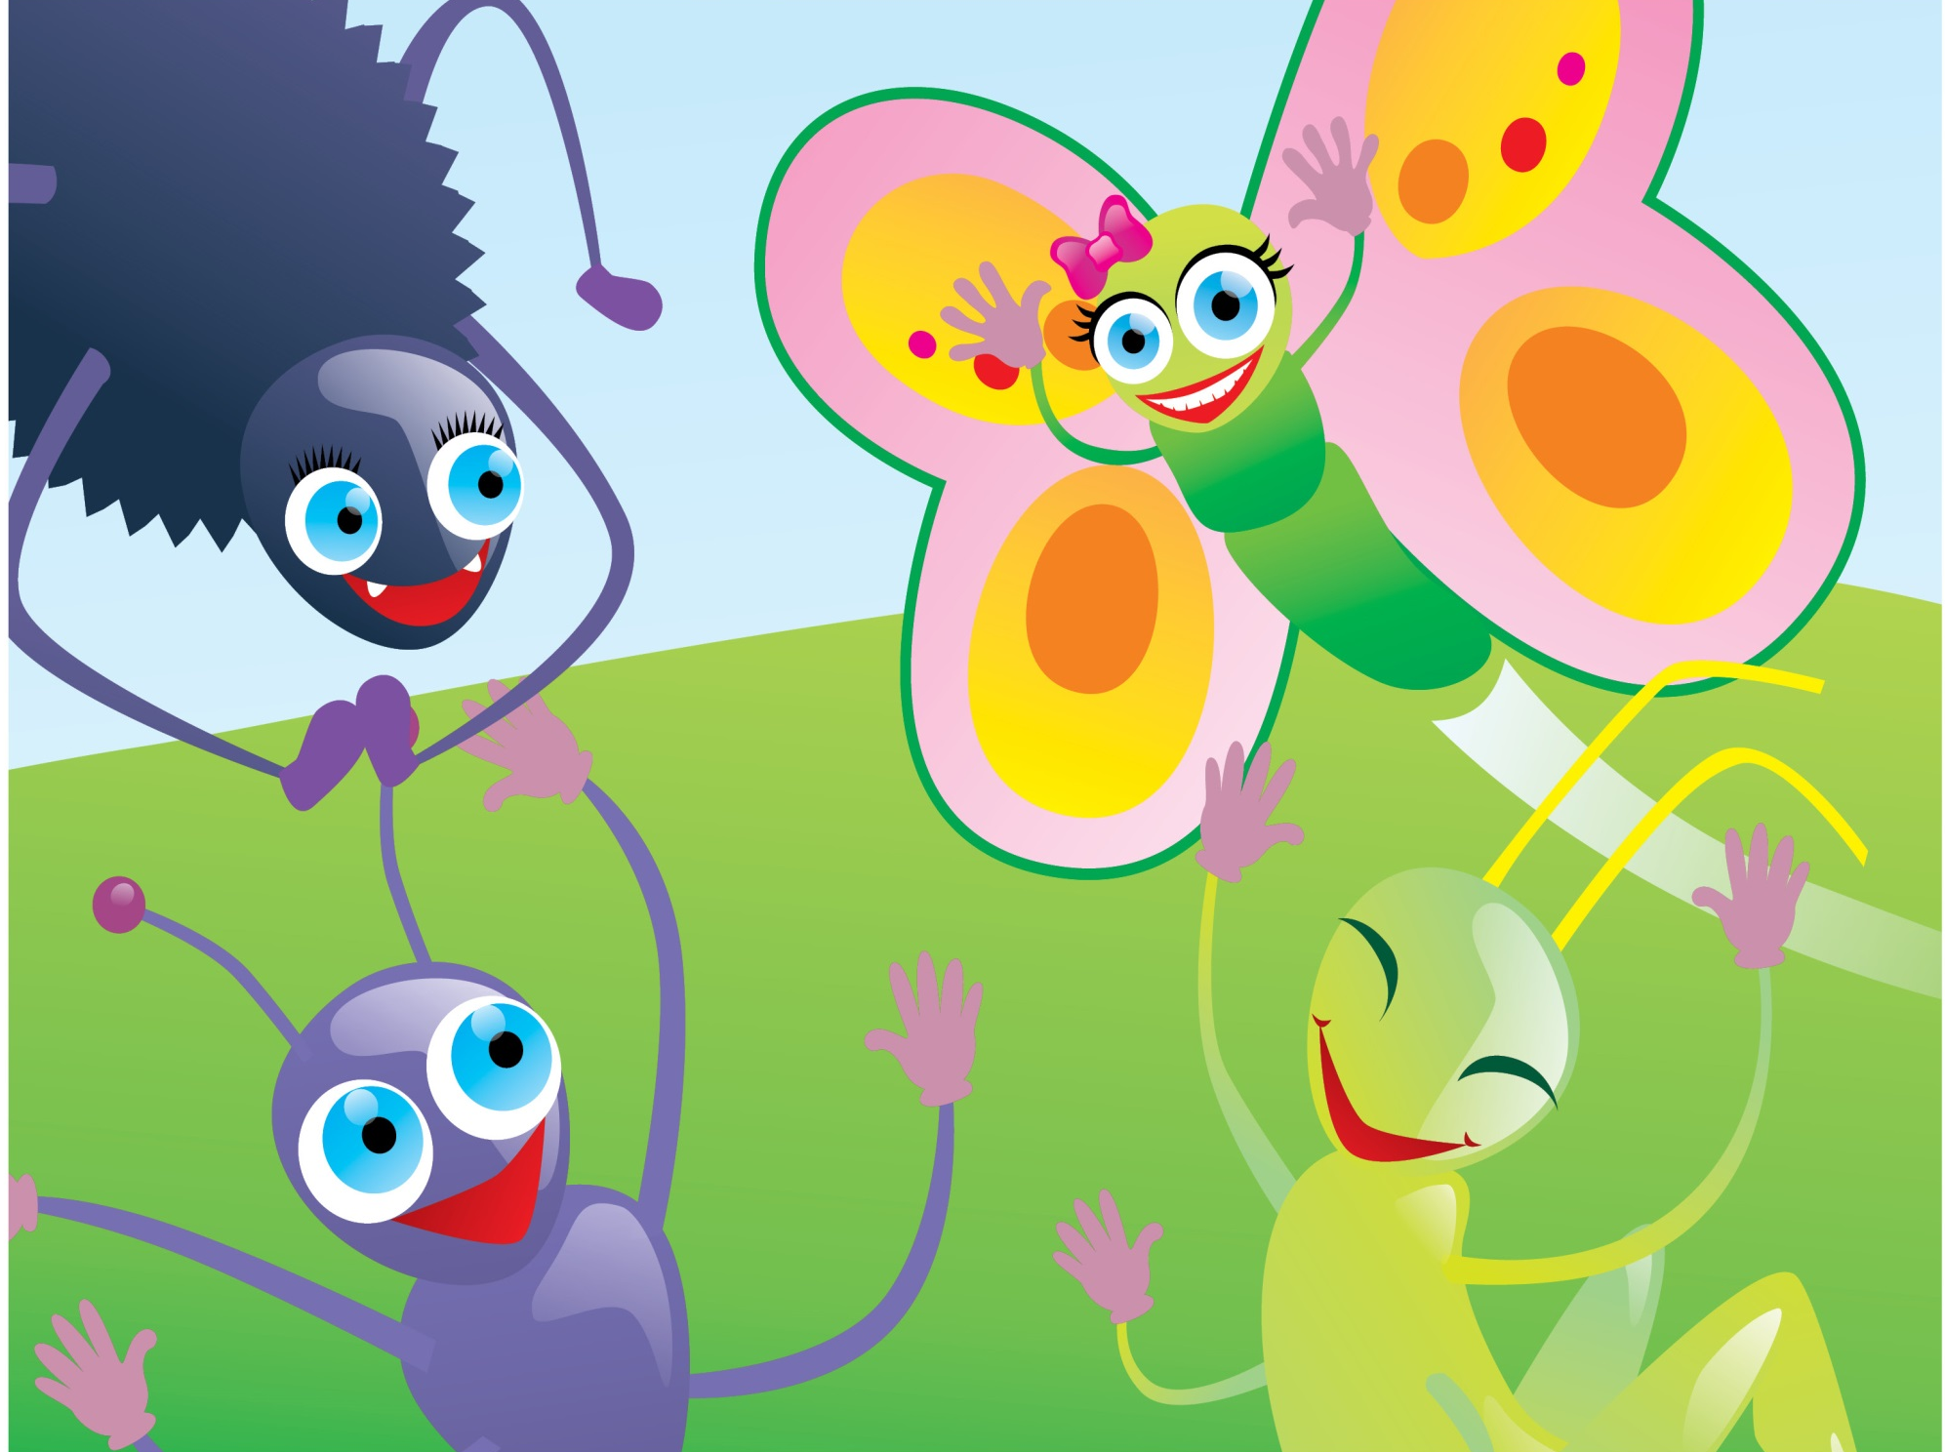

Slide 8
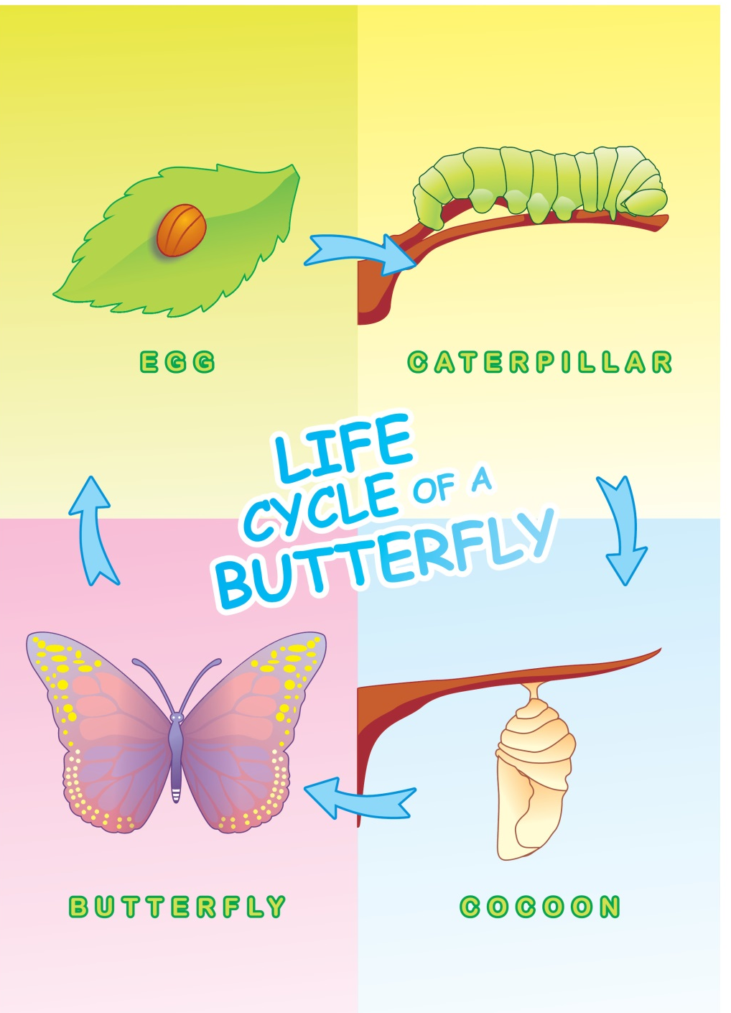
First, it’s an egg.
Then, it’s a small caterpillar. It eats a lot of food.
And, then, it gets into a cocoon. It sleeps and sleeps and sleeps. And … then… it’s a beautiful butterfly.

Slide 9
ant

Slide 10
spider

Slide 11
cricket

Slide 12
tree

Slide 13
forest

Slide 14
caterpillar

Slide 15
sad

Slide 18
leaf

Slide 19
hungry

Slide 20
pear

Slide 21
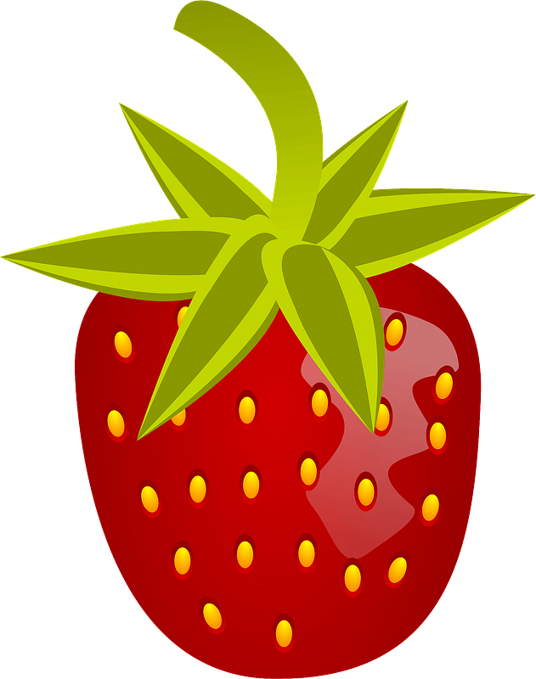
strawberries

Slide 22
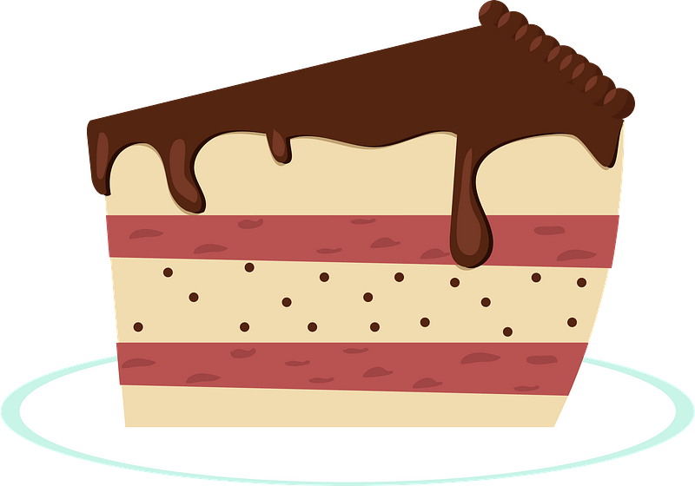
cakes

Slide 23
carrots

Slide 24
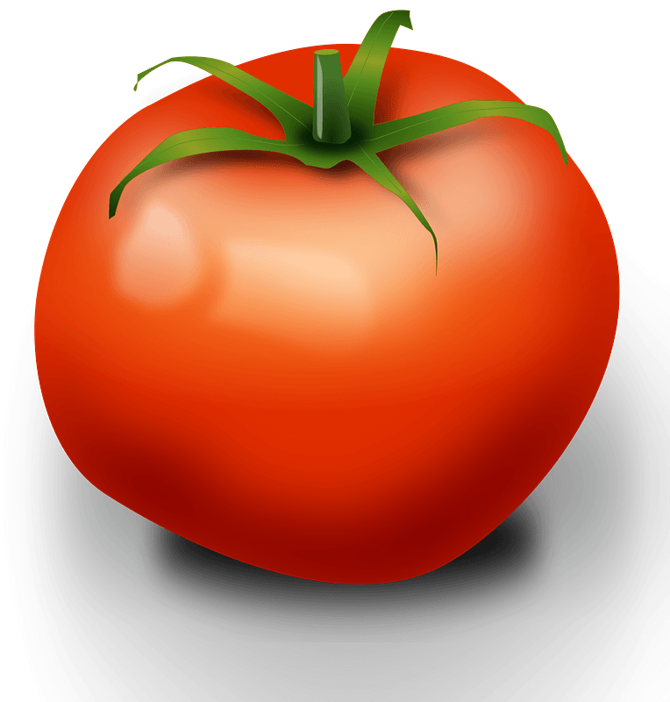
tomatoes

Slide 25
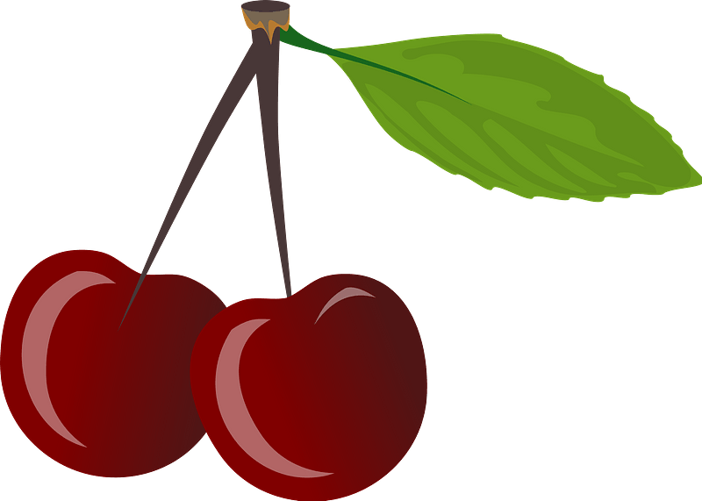
cherries

Slide 26
candies

Slide 27
chips

Slide 28
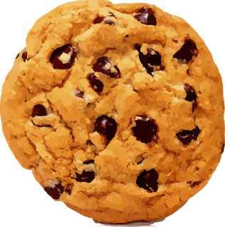
cookies

Slide 29
Green beans

Slide 30
beautiful

Slide 31
butterfly

Slide 32
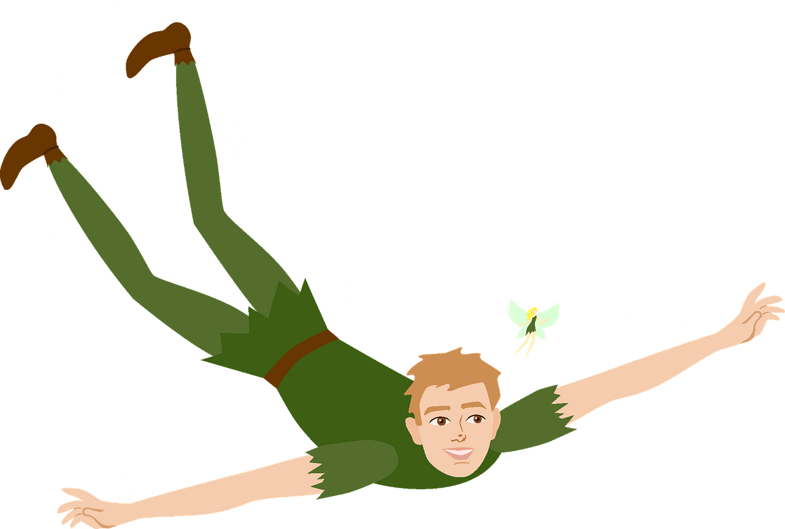
fly

Slide 33
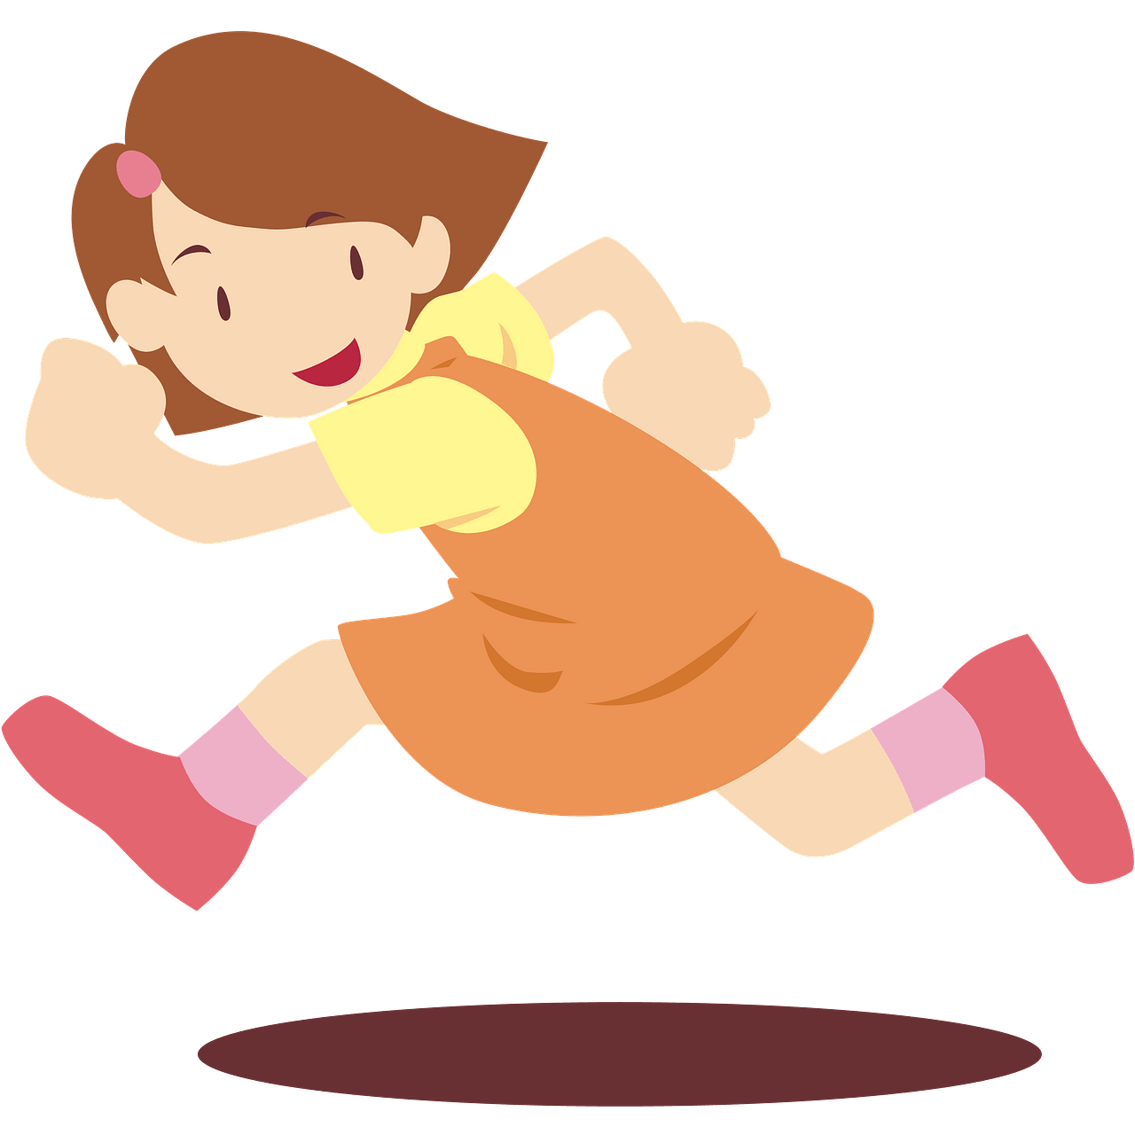
run

Slide 34
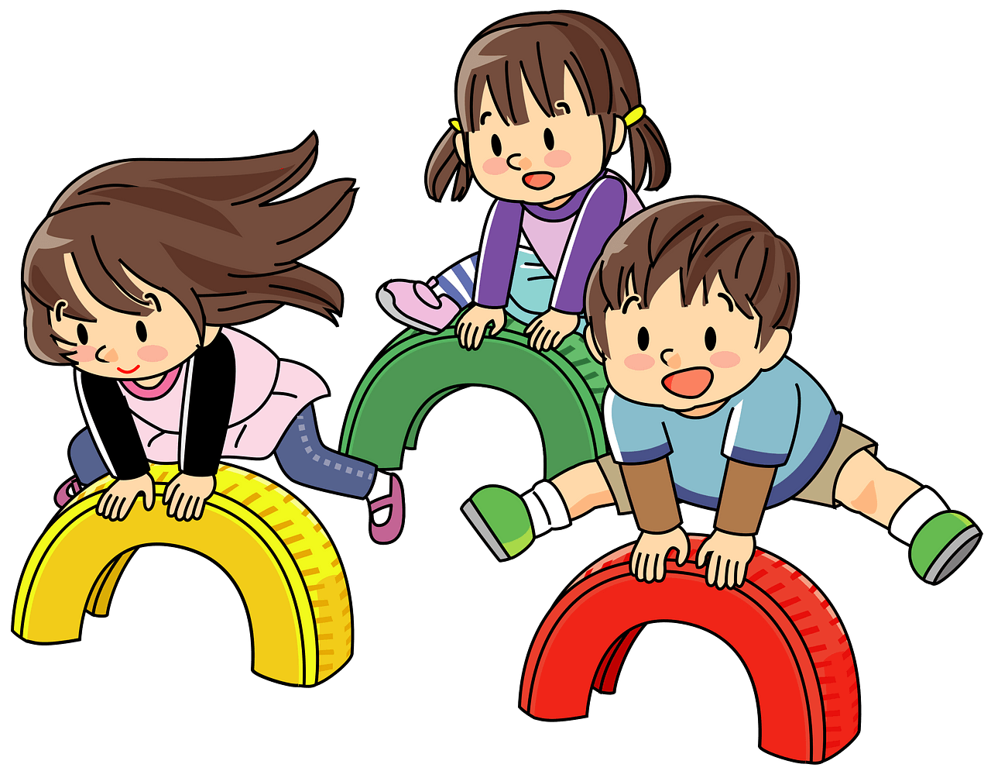
jump

Slide 35
climb

Slide 36
sing

Slide 37
egg
caterpillar
butterfly
cocoon

