Slide 1
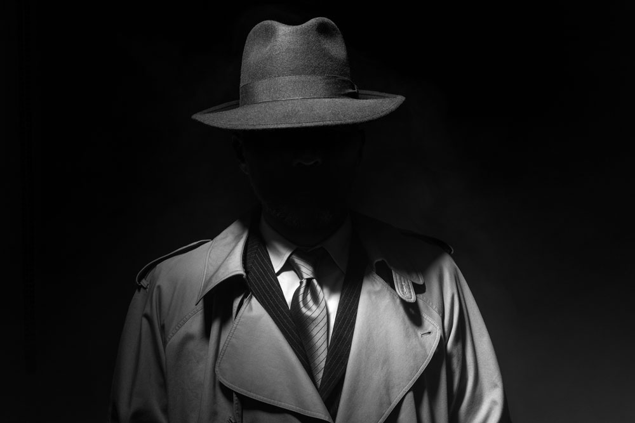
Guy Fawkes and Bonfire Night

Slide 2
Who is Guy Fawkes? (You’ve got 3 minutes to find out – go to Google search and write down his name)

Slide 3
What is a Bonfire?
Go to
GOOGLE – IMAGES
to see one!!!

Slide 4
When is Bonfire Night?
Go to google search and find out!!!
Bonfire Night is on…………………….

Slide 5
What are toffee apples?
Send me a picture to paste here

Slide 6
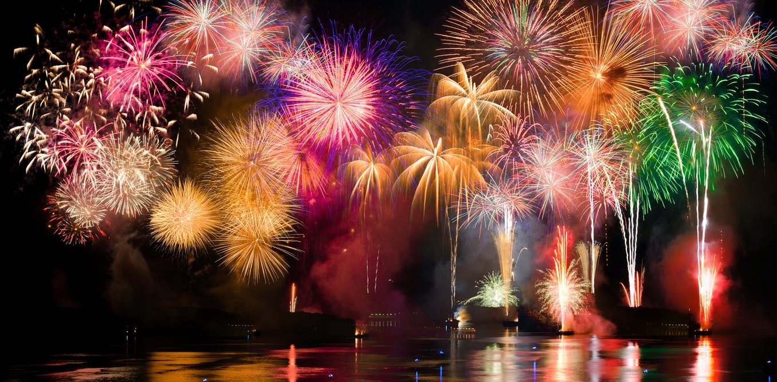
What are fireworks?
-Do you like fireworks?
-When do we light fireworks?

Slide 7
Congratulations!!!
You now know everything about Guy Fawkes and the Bonfire night.
THE END…

