Slide 1
A party in the jungle

Slide 2
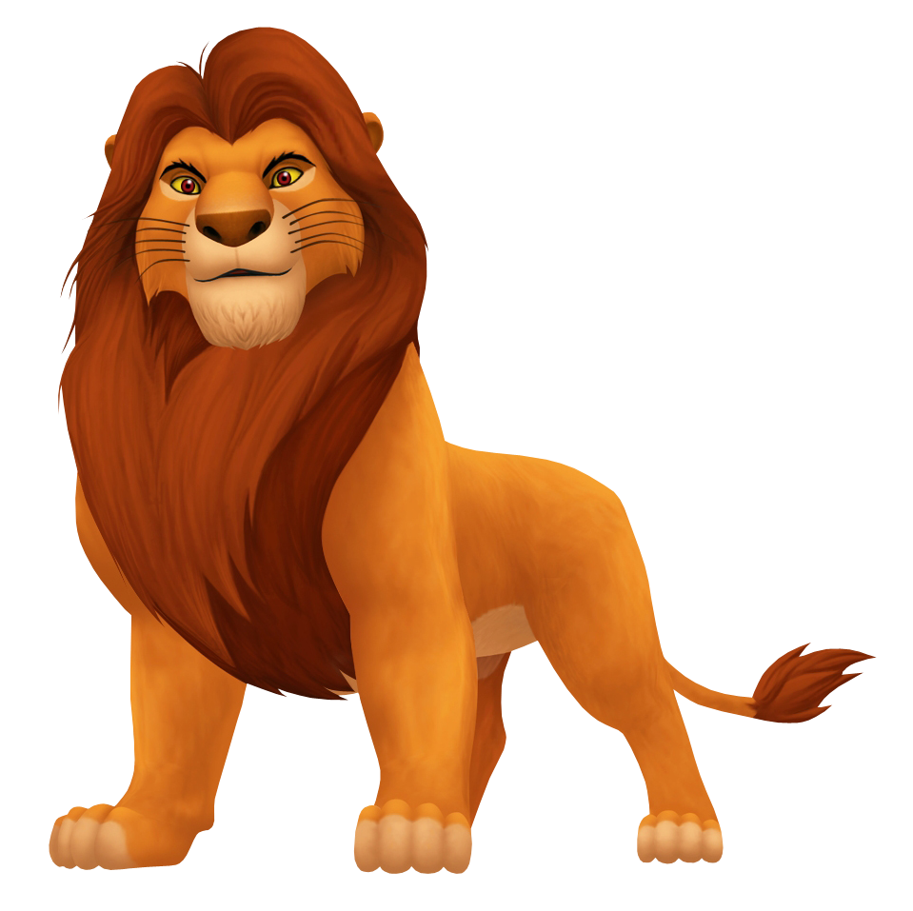
Deep in the African jungle lives a small lion. His name’s Leo.

Slide 3
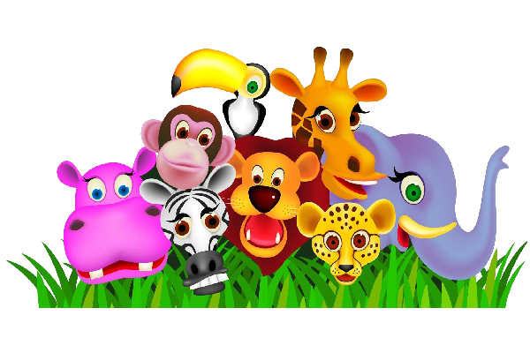
Leo has a lot of friends: Zebra, Monkey, Hippo, Parrot, Tiger, Elephant and Giraffe.

Slide 4
Today is Leo’s birthday.

Slide 5
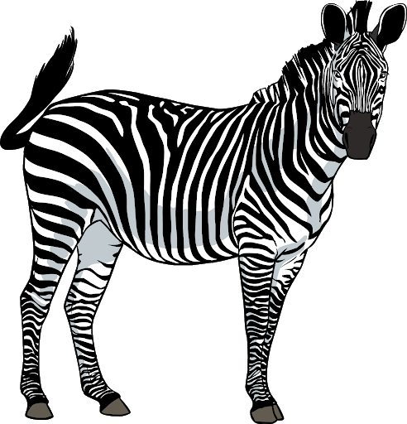
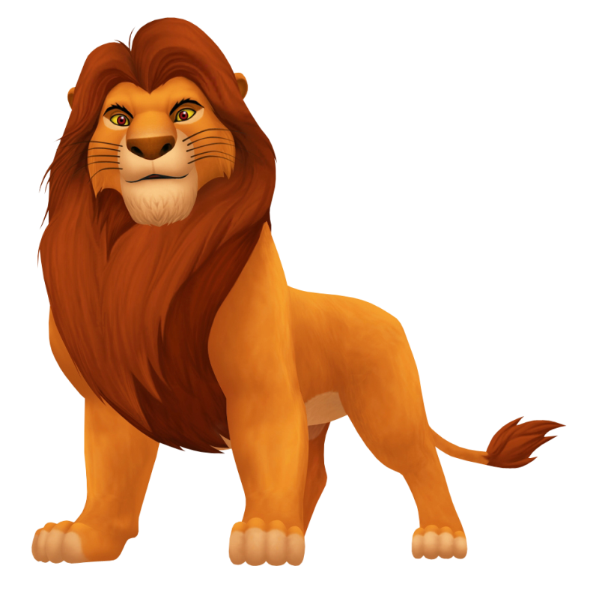
“Happy birthday, Leo”, says Zebra and gives him a little present. It’s a blue and red ball. “Thank you, Zebra”, says Leo.

Slide 6
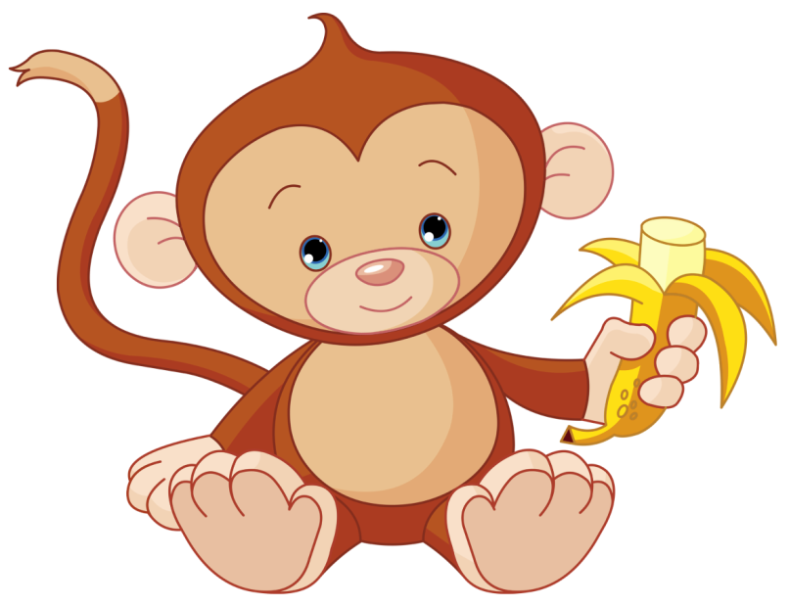
“Happy birthday, Leo”, says Monkey and gives him a yummy banana. “Thank you, Monkey”, says Leo.

Slide 7
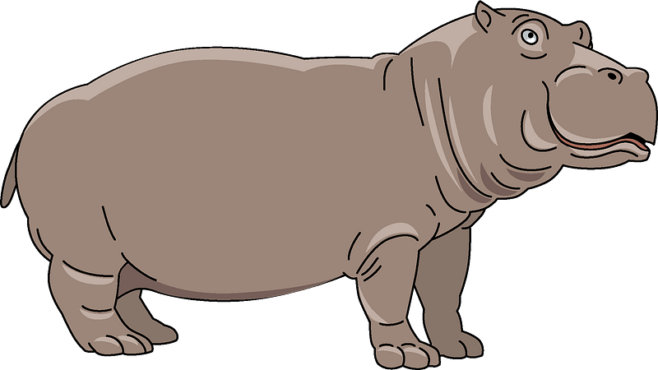
“Happy birthday, Leo”, says Hippo and gives Leo a beautiful flower. It’s a pink daisy. “Thank you, Hippo”, says Leo.

Slide 8
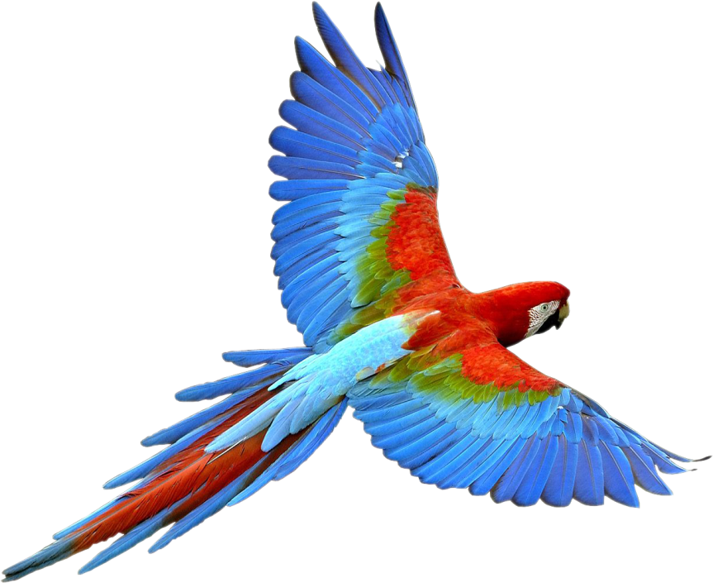
“Happy birthday, Leo”, says Parrot and gives Leo a juicy carrot. “Thank you, Parrot”, says Leo.

Slide 9
“Happy birthday, Leo” says Tiger and gives Leo a yellow yo-yo. “Thank you, Tiger”, says Leo.

Slide 10
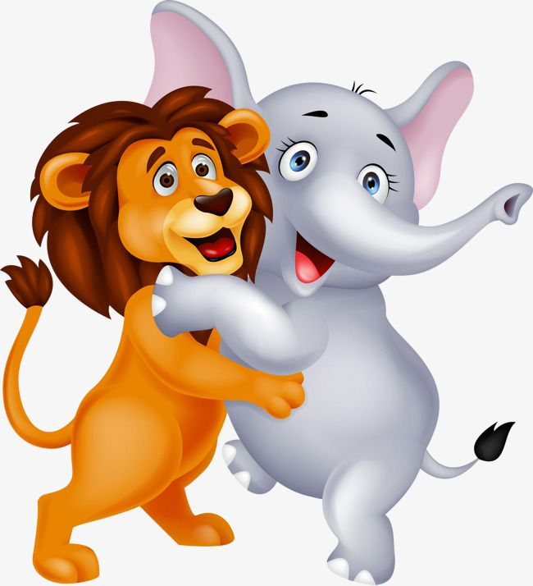
“Happy birthday, Leo”, says Elephant and gives Leo a big hug. “Thank you Elephant”, says Leo.

Slide 11
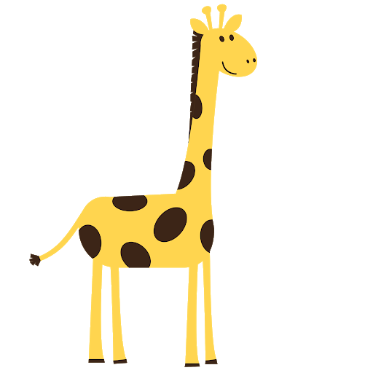
“Happy birthday”, says Giraffe and gives Leo a kiss. “Thank you, Giraffe”, says Leo.

Slide 12
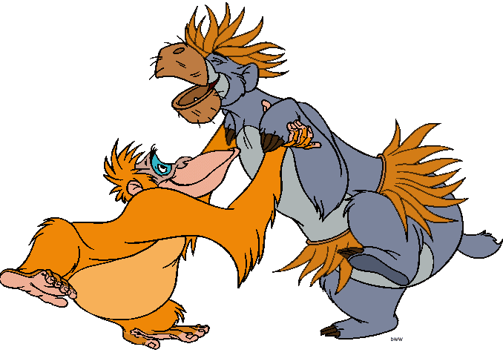
“Come on, my friends, let’s have a party. Let’s dance the jungle dance”. Leo and his friends are very happy.

