Slide 1
Feelings

Slide 2
happy

Slide 3
hungry

Slide 4
bored

Slide 5
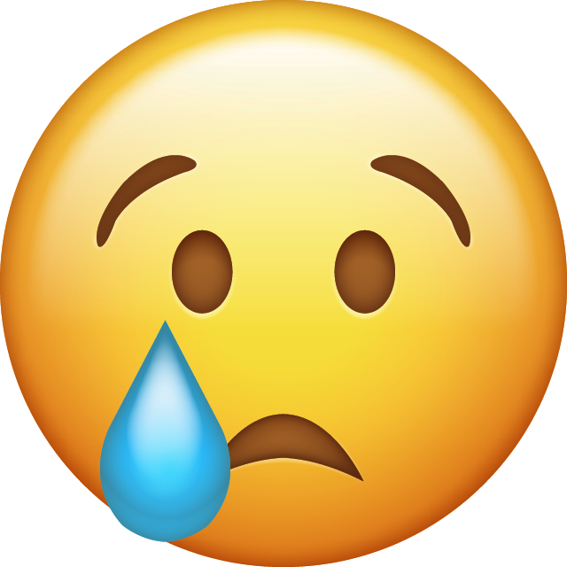
sad

Slide 6
scared

Slide 7
angry

Slide 8
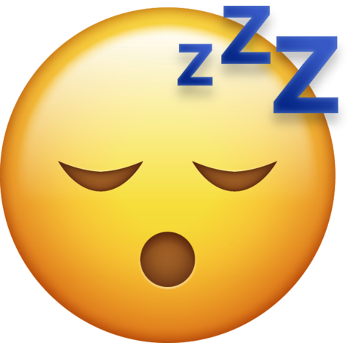
sleepy

Slide 9
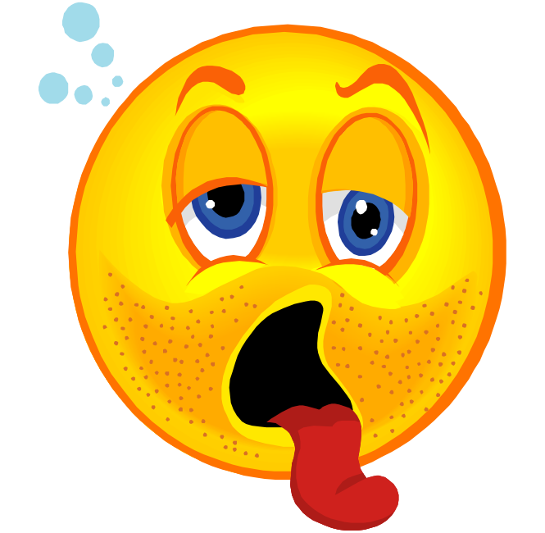
thirsty

