Slide 1
Grade B
Can a monkey fly?
Ms. Dimitra

Slide 2
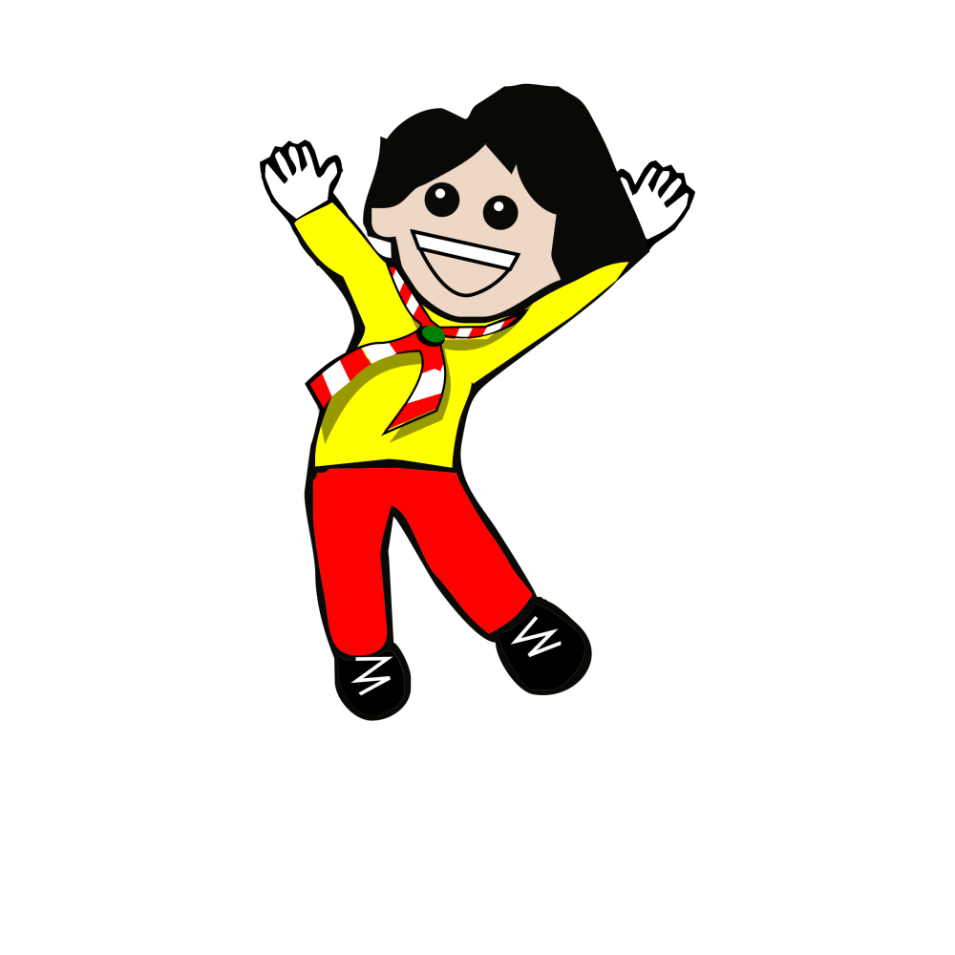
Jump

Slide 3
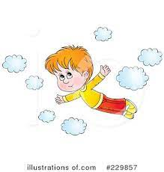
Fly

Slide 4
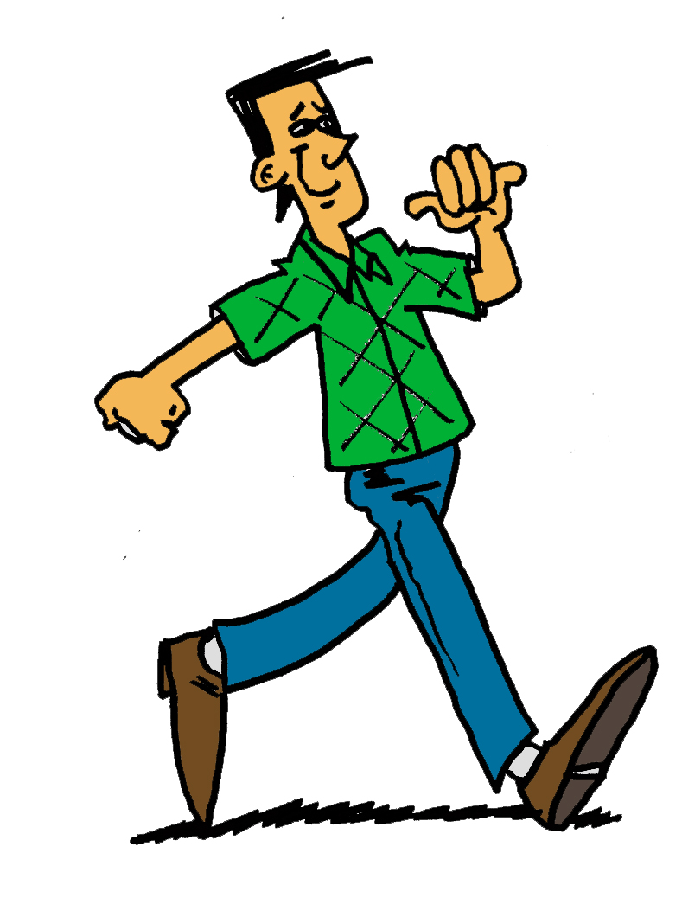
Walk

Slide 5
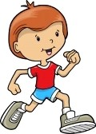
Run

Slide 6
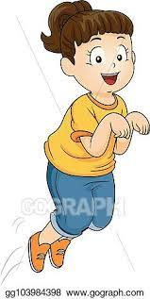
Hop

Slide 7

Clap

Slide 8

Swim

Slide 9
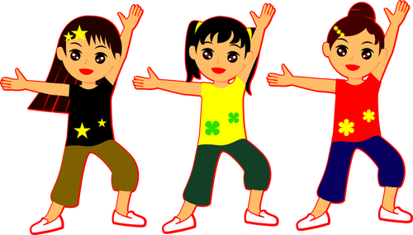
Dance

Slide 10
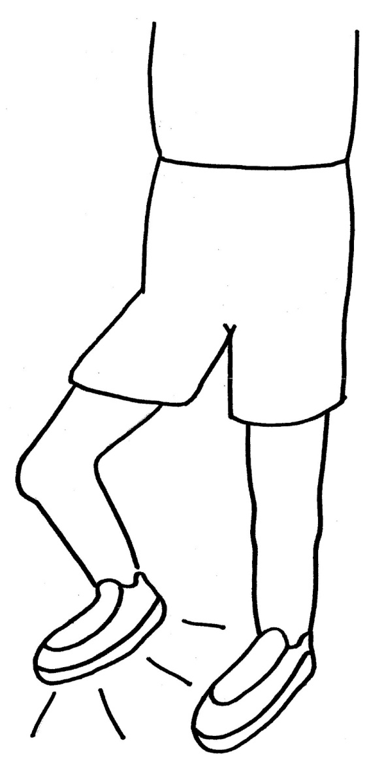
Stomp

Slide 11
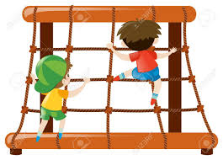
Climb

Slide 12
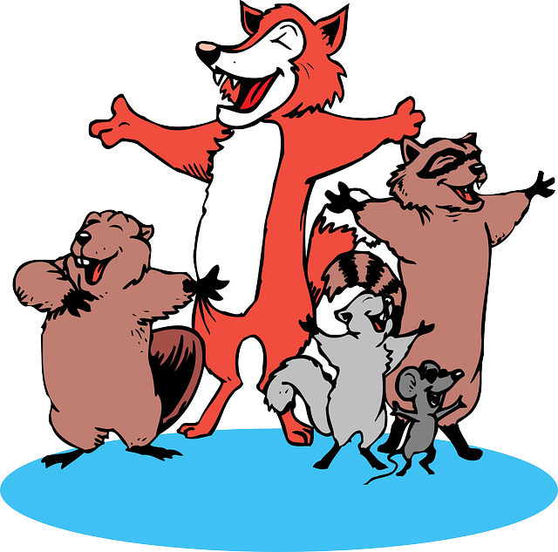
Sing

Slide 13
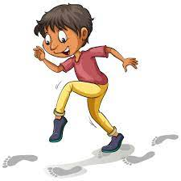
Tiptoe

Slide 14

Sleep

