Slide 1
Action verbs

Slide 2
If you are happy…
https://www.youtube.com/watch?v=l4WNrvVjiTw
(stomp/clap)

Slide 3
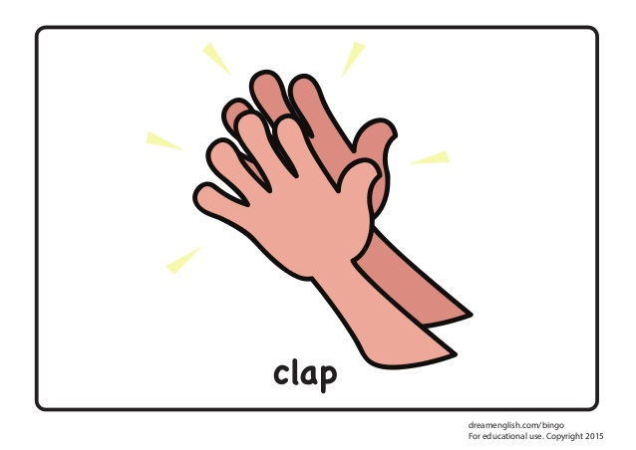

Slide 5
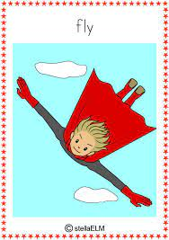

Slide 6
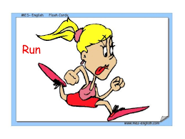

Slide 7
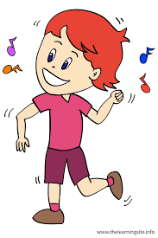

Slide 8
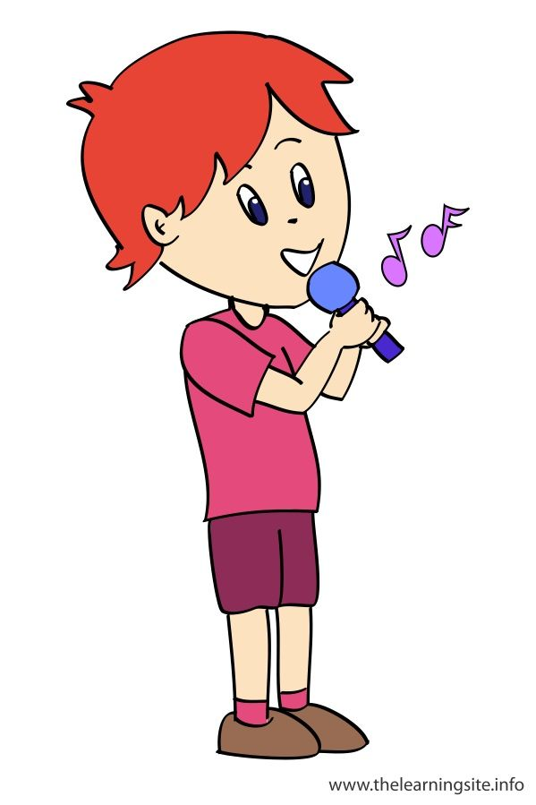

Slide 9
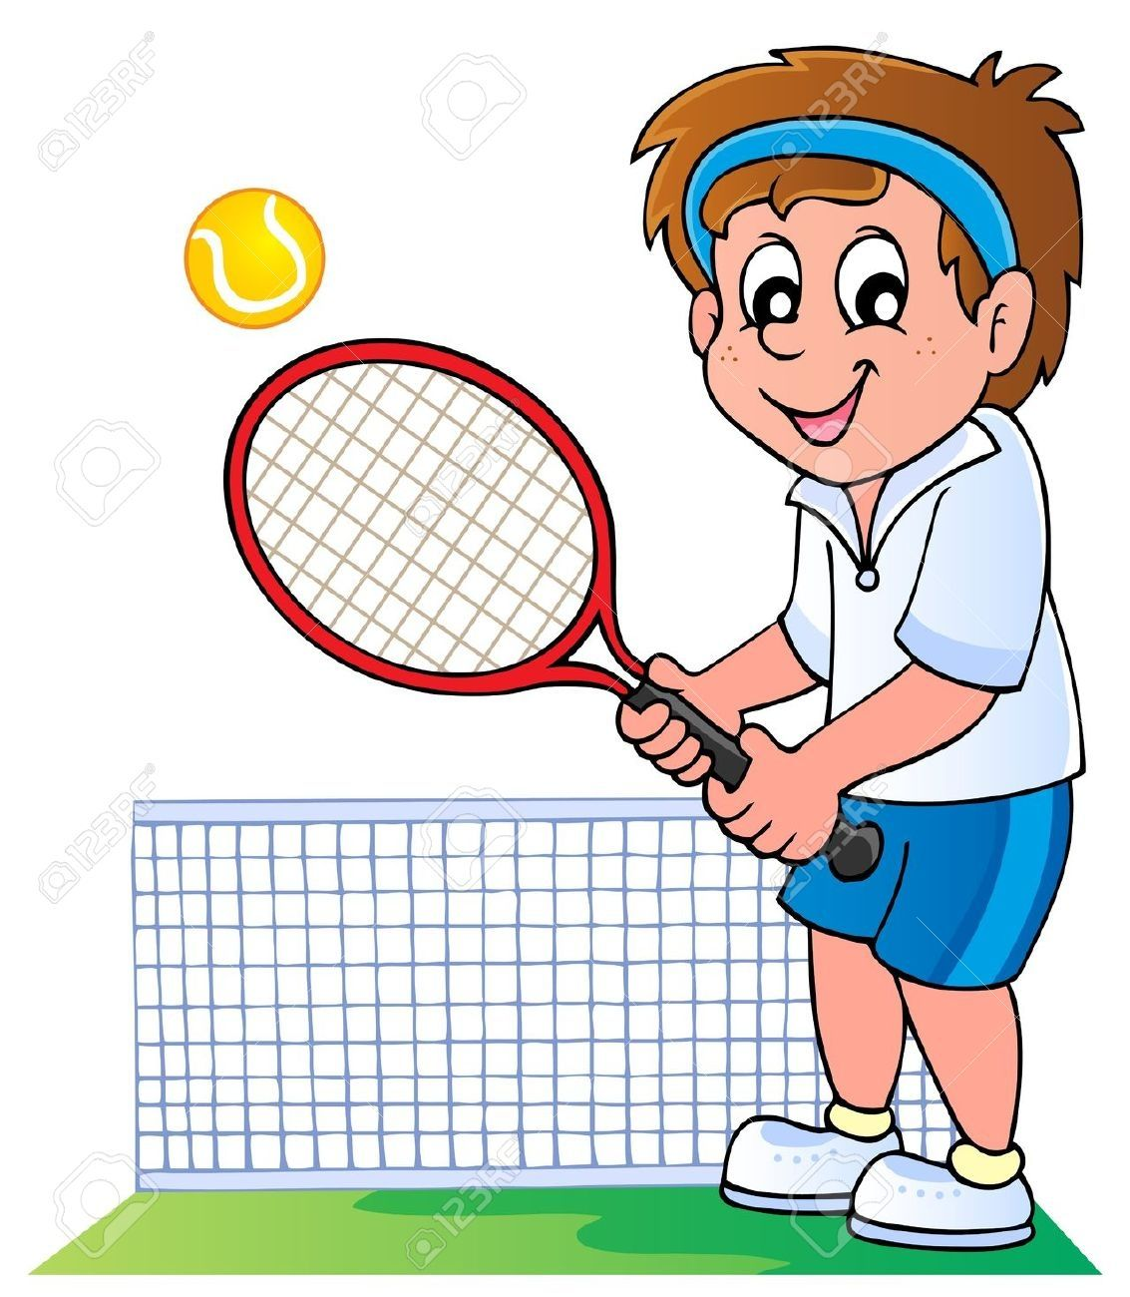

Slide 10
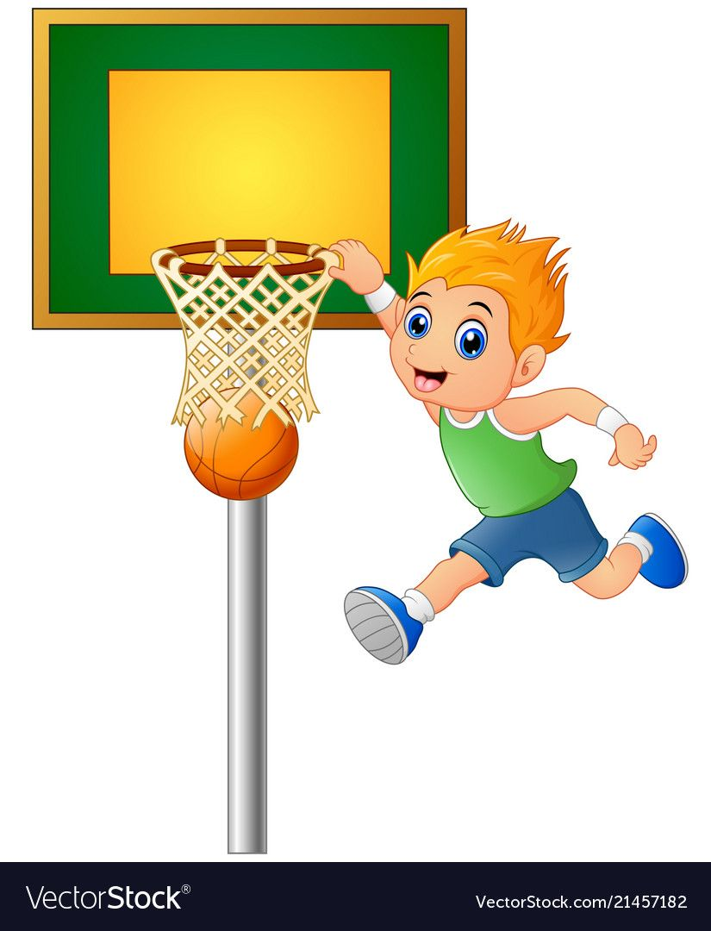

Slide 11
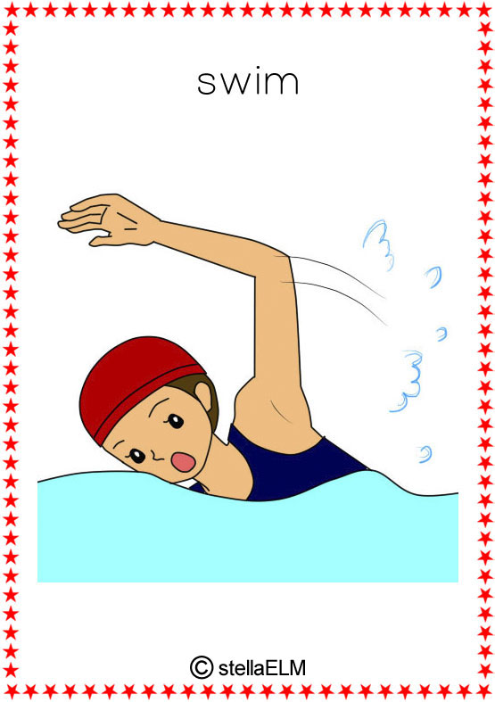

Slide 12
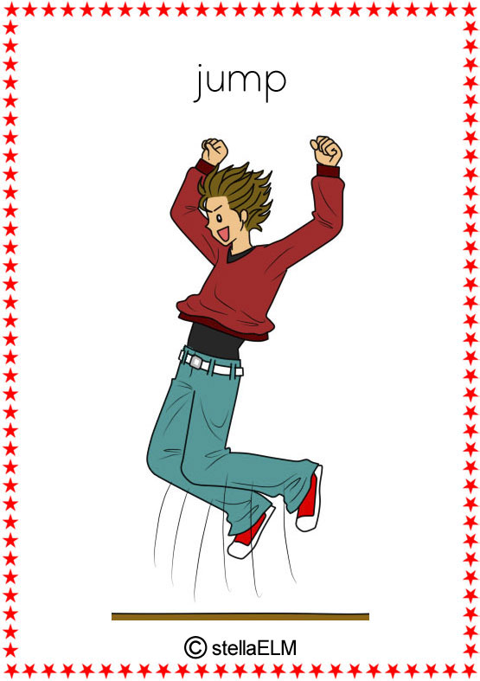

Slide 13
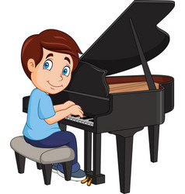

Slide 14
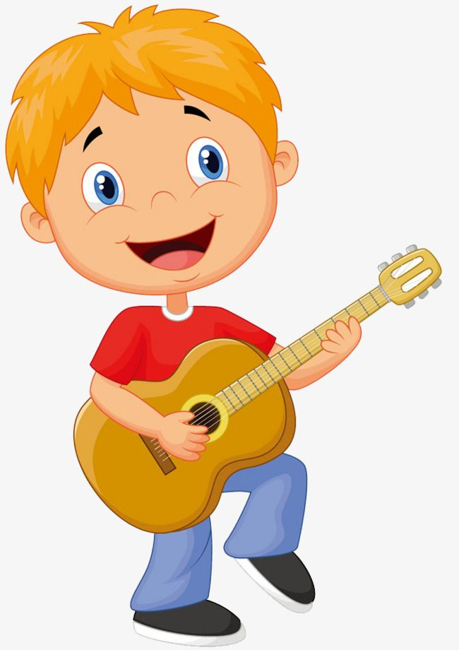

Slide 15
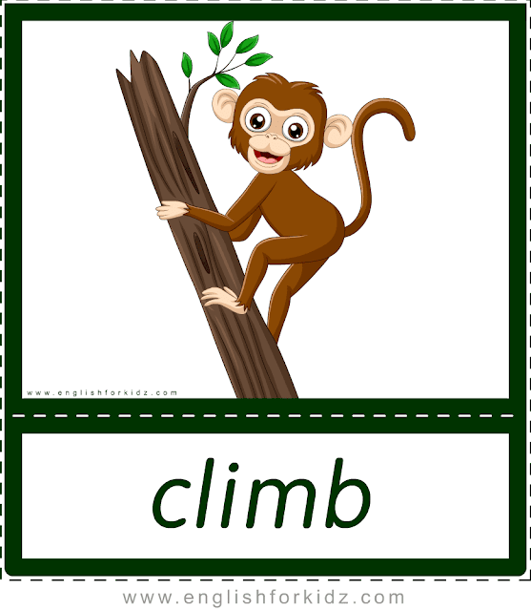

Slide 16
Can you???
https://www.youtube.com/watch?v=_Ir0Mc6Qilo

Slide 17
Now, it’s your turn!!!
Can you….?
Yes, I can.
No, I can’t.
Short oral practice first and then….

Slide 18
Open the box…!!!!
https://wordwall.net/resource/12684471/can-you

